Slide 1
Robocup Logistics League Laboratory of AI
Artificial Intelligence Department University of Freiburg
Organizers: Andreas Hertle, Prof. Dr. Bernhard Nebel
25.07.2017
Grigorios Mouratidis
Mostafa Hussein
Eduardo Alvarado

Slide 2
Outline
Robocup Logistics League (RCLL)
Complexities
Stations
Algorithmic Approach
Problems and Solutions
Future work

Slide 3
Outline
Robocup Logistics League (RCLL)
Complexities
Stations
Algorithmic Approach
Problems and Solutions
Future work

Slide 4
Robocup Logistics League (RCLL)
International robotics competition RoboCup.
Focus on factory logistic applications.
Tasks:
Fetch materials
Transport between machines
Handle production at these machines
Deliver them to the delivery station
Notes:
The aim is to provide a simplified Smart Factory environment.

Slide 5
Outline
Robocup Logistics League (RCLL)
Complexities
Stations
Algorithmic Approach
Problems and Solutions
Future work

Slide 6
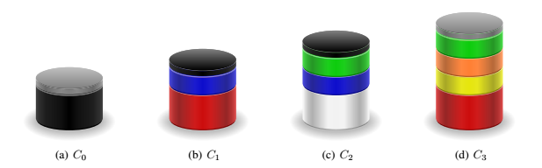
Complexities
Notes:
The complexity level is stated as the number of required intermediate rings.

Slide 7
Outline
Robocup Logistics League (RCLL)
Complexities
Stations
Algorithmic Approach
Problems and Solutions
Future work

Slide 8
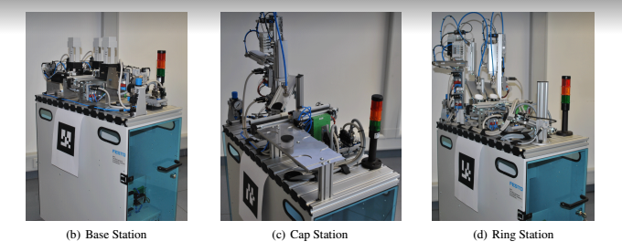
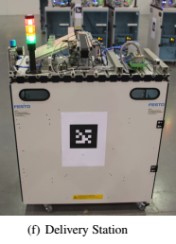
Stations
Notes:
BS: Deliver base elements. One Single BS per team.
CS: Mounts a cap as the final step in production on an intermediate product. There are 2 CS per team.
RS: Mounts a colored ring out of two available colors on an intermediate product. There are 2 RS per team.
DS: Accept complete products. One Single DS per team.

Slide 9
Outline
Robocup Logistics League (RCLL)
Complexities
Stations
Algorithmic Approach
Problems and Solutions
Future work

Slide 10
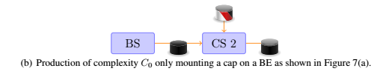

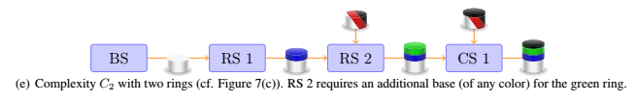
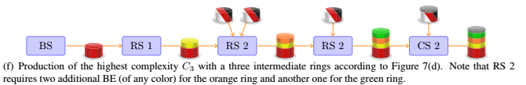
Algorithmic Approach
Complexity 0
Complexity 1
Complexity 2
Complexity 3

Slide 11
Outline
Robocup Logistics League (RCLL)
Complexities
Stations
Algorithmic Approach
Problems and Solutions
Future work

Slide 12
Problems & Solutions
Machines Down – Not Ready
Waiting time until machine is RO
Delivery time is out of the range
Early: Wait until the correct timing is there
Late: Just deliver
Caps (Left, Middle, Right)
Shifting between the sides for each order

Slide 13
Outline
Robocup Logistics League (RCLL)
Complexities
Stations
Algorithmic Approach
Problems and Solutions
Future work

Slide 14
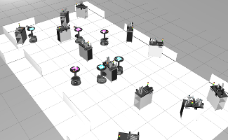
Future Work
Cooperation between the 3 robots
(Multi-Agent System)

Slide 15

Robocup Logistics League (RCLL)
Thank you!

